Slide 1
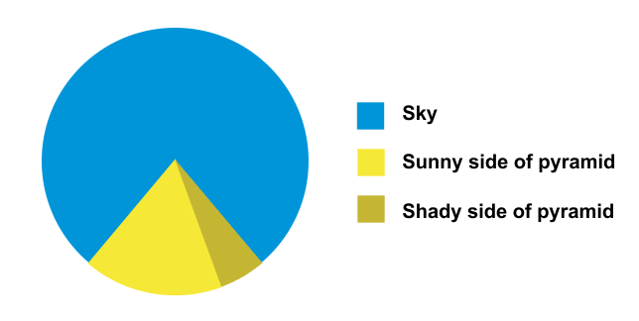
A lightning quick introduction to data visualization
Andrew Heiss, PhD
Brigham Young University
West Coast Nonprofit Data Conference
April 27, 2018

Slide 2
Plan for today
Why visualize data?
Types of visualizations
Aesthetics and design
How do I do all this?
Take a sad plot and make it better

Slide 3
talks.andrewheiss.com/wcnpd18

Slide 4
Why visualize data?

Slide 5
Theories are only stories until you have some data.
Data alone cannot tell stories or prove theories.

Slide 6
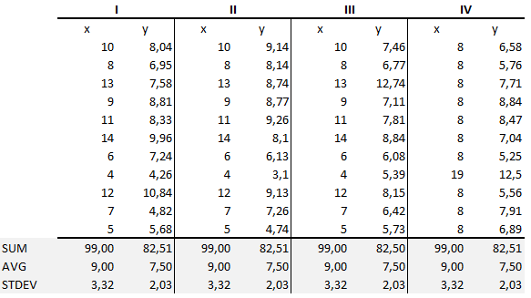

Slide 7
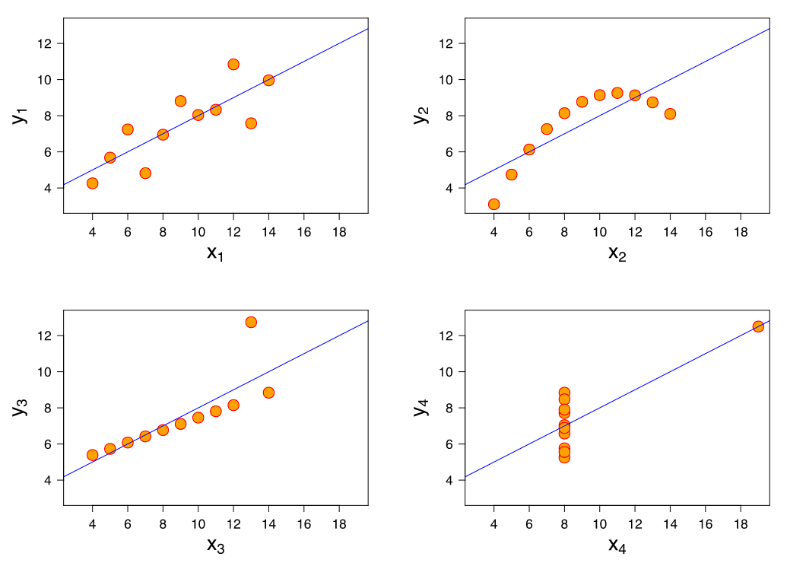

Slide 8

Never trust summary statistics alone
Notes:
The Datasaurus Dozen: https://www.autodeskresearch.com/publications/samestats

Slide 9
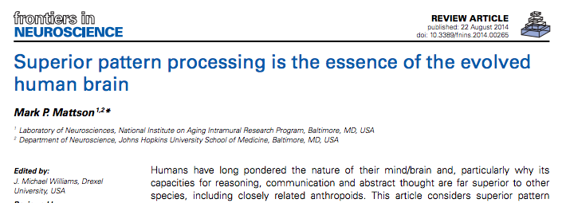


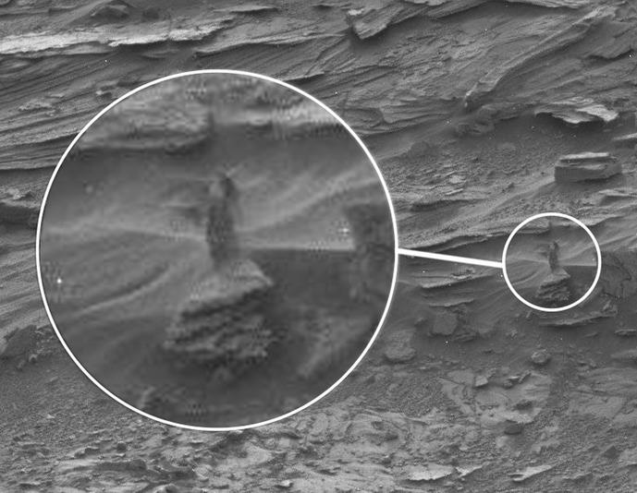

Humans are visual creatures
@FacesPics

Slide 10
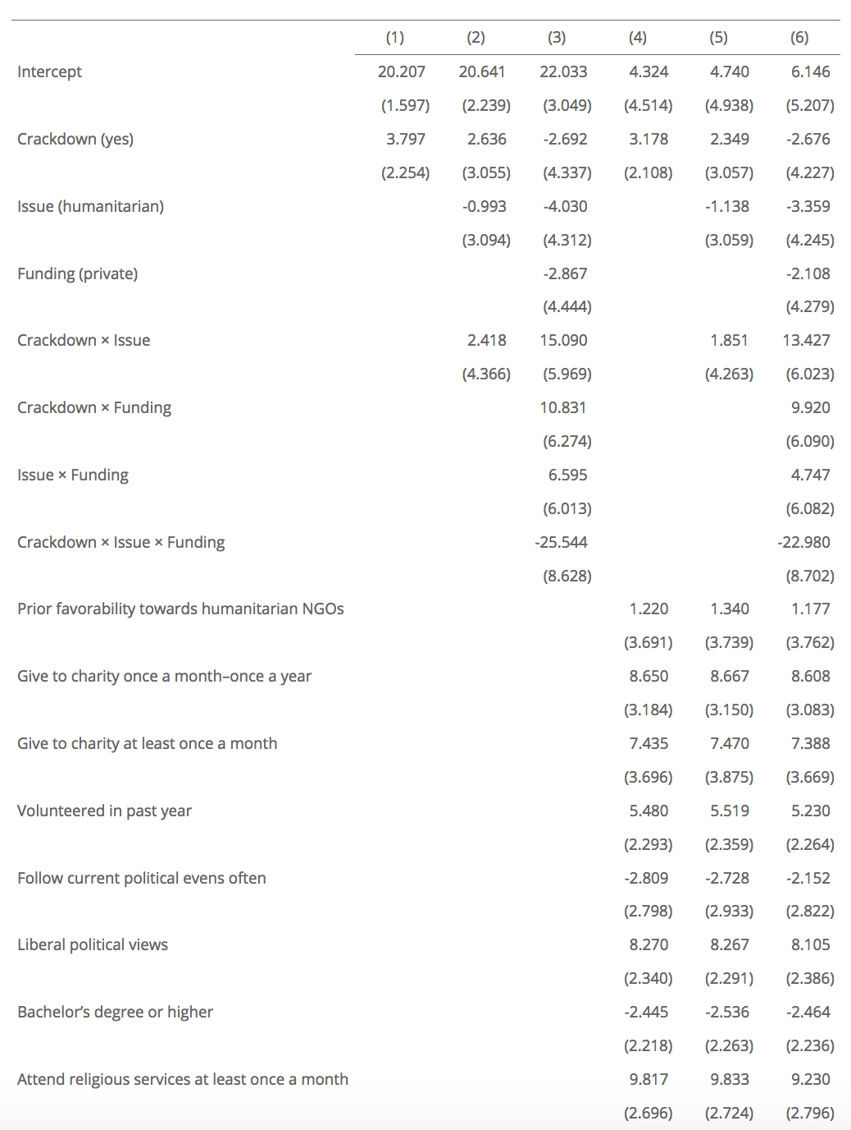
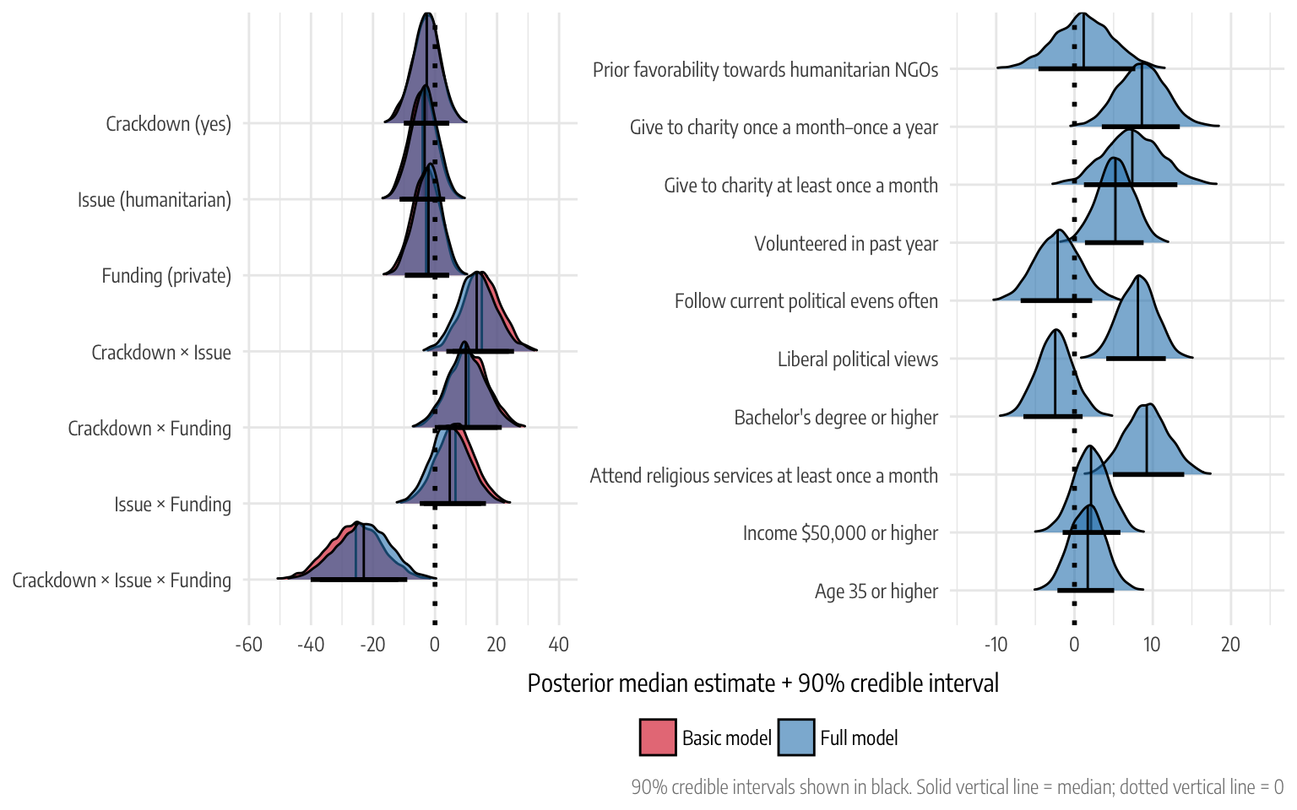

Slide 11
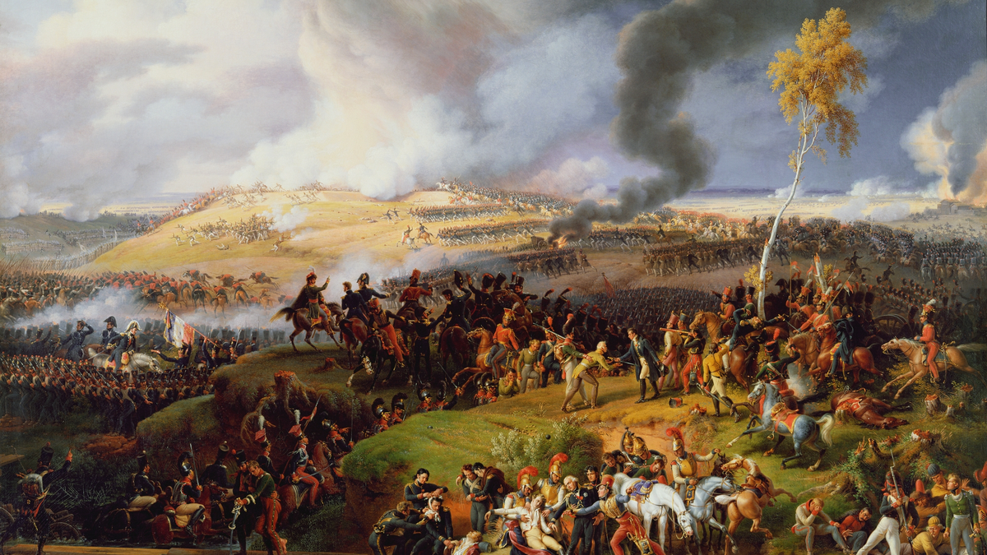

Slide 12
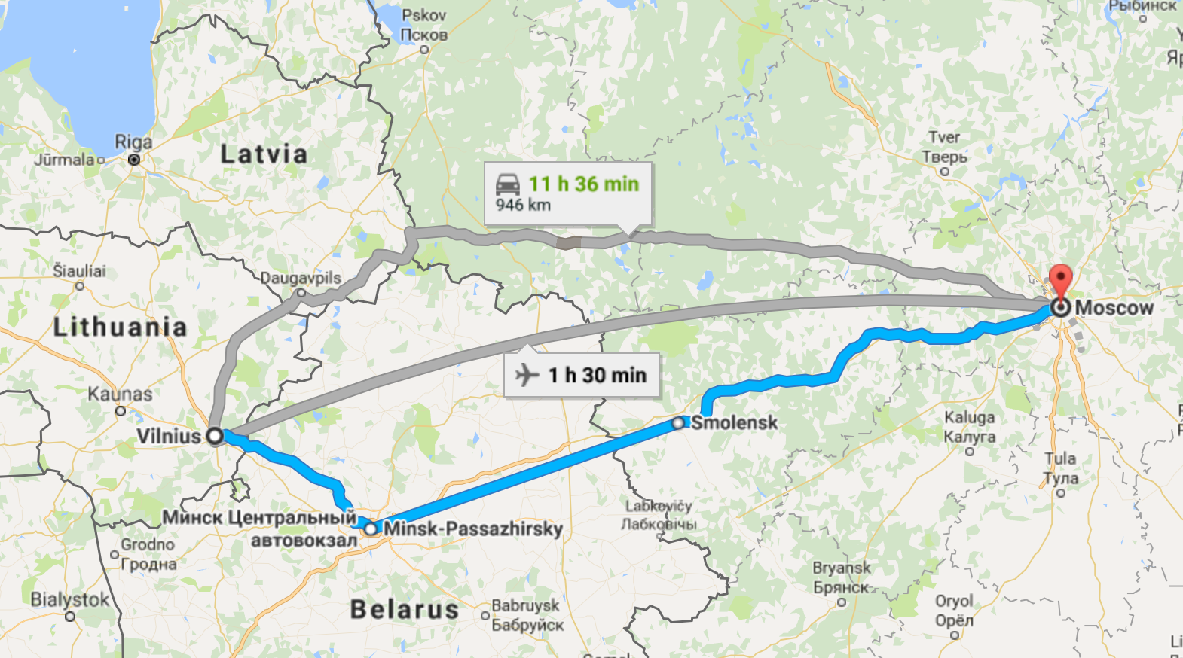
The War of 1812 (the European one)
Long distance!

Slide 13
The War of 1812 (the European one)
Very cold!

Slide 14
The War of 1812 (the European one)
Very sad!

Slide 15

Notes:
6 variables: lat/lon + army size + direction + date + temperature

Slide 16
Characteristics of graphical excellence
1. “... the well-designed presentation of interesting data—a matter of substance, statistics, and design.”
2. Complex ideas communicated with clarity, precision, and efficiency.
3. That which gives the viewer the greatest number of ideas in the shortest time with the least ink in the smallest space.
4. Nearly always multivariate.
5. Requires telling the truth about the data.

Slide 17
What makes Minard’s graph so great?

Slide 18

We forget this!

Slide 19
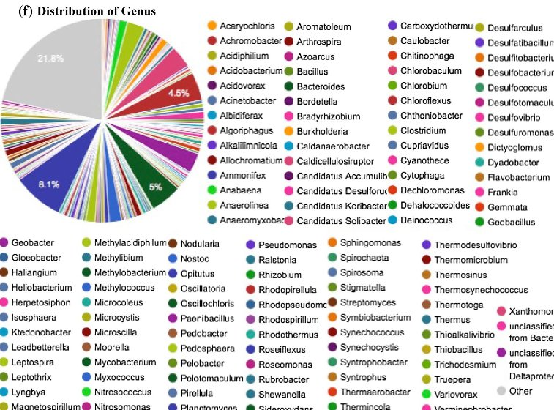

Slide 20
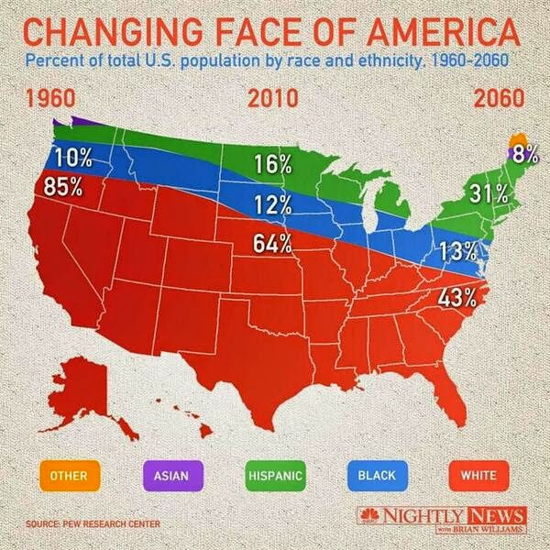

Slide 21
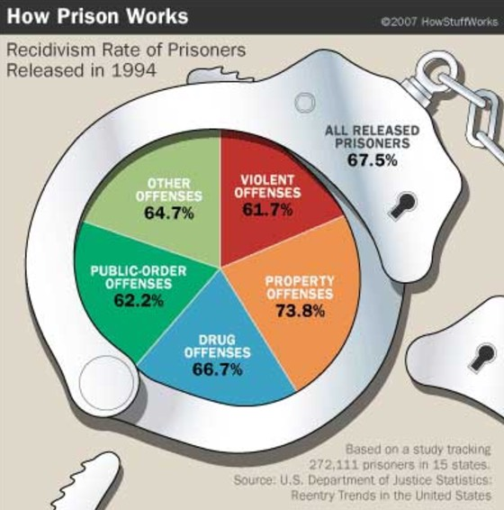

Slide 22

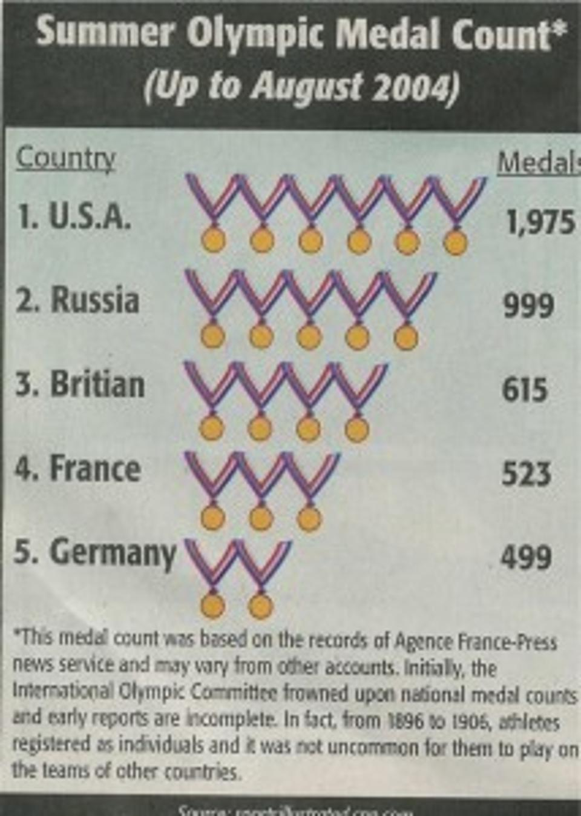

Slide 23
Types of visualizations

Slide 24
Exploratory visualizations
Academic-ish
Quick scatterplots, histograms, other charts to help understand your data
Explanatory visualizations
Publishable
Consumable by the general public; Vox, NYT, Washington Post, FiveThirtyEight, etc.

Slide 25
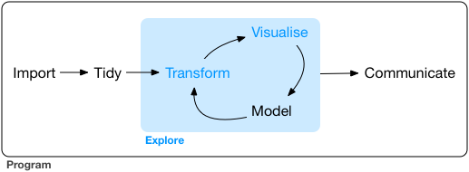
Exploratory
Explanatory

Slide 26
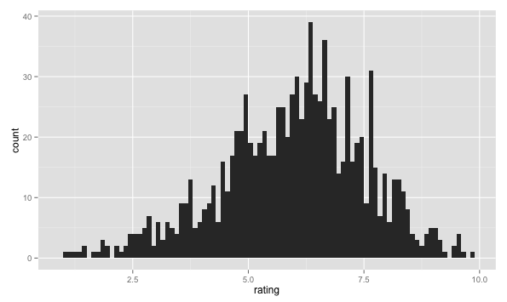
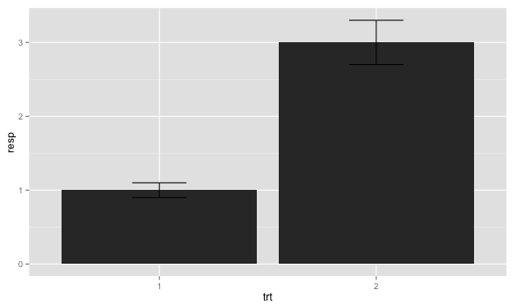
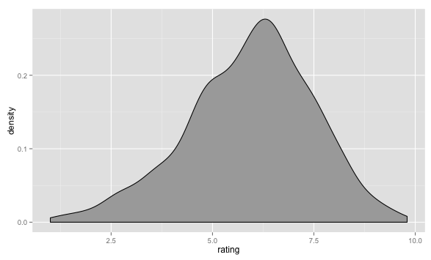
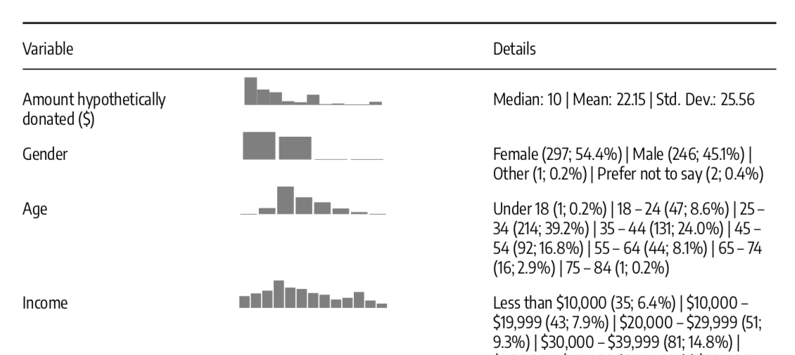
Exploratory data analysis
Visualize every variable individually

Slide 27
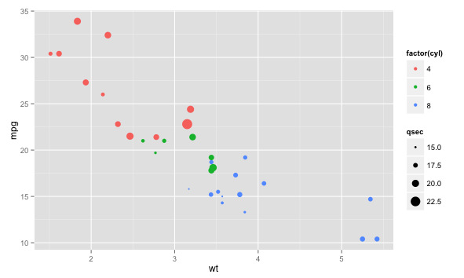
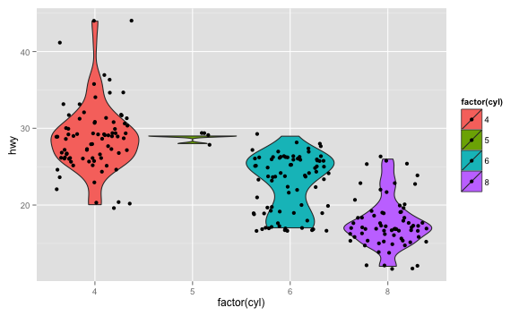
Exploratory data analysis
Visualize relationships between each variable
Notes:
https://github.com/zonination/perceptions

Slide 28
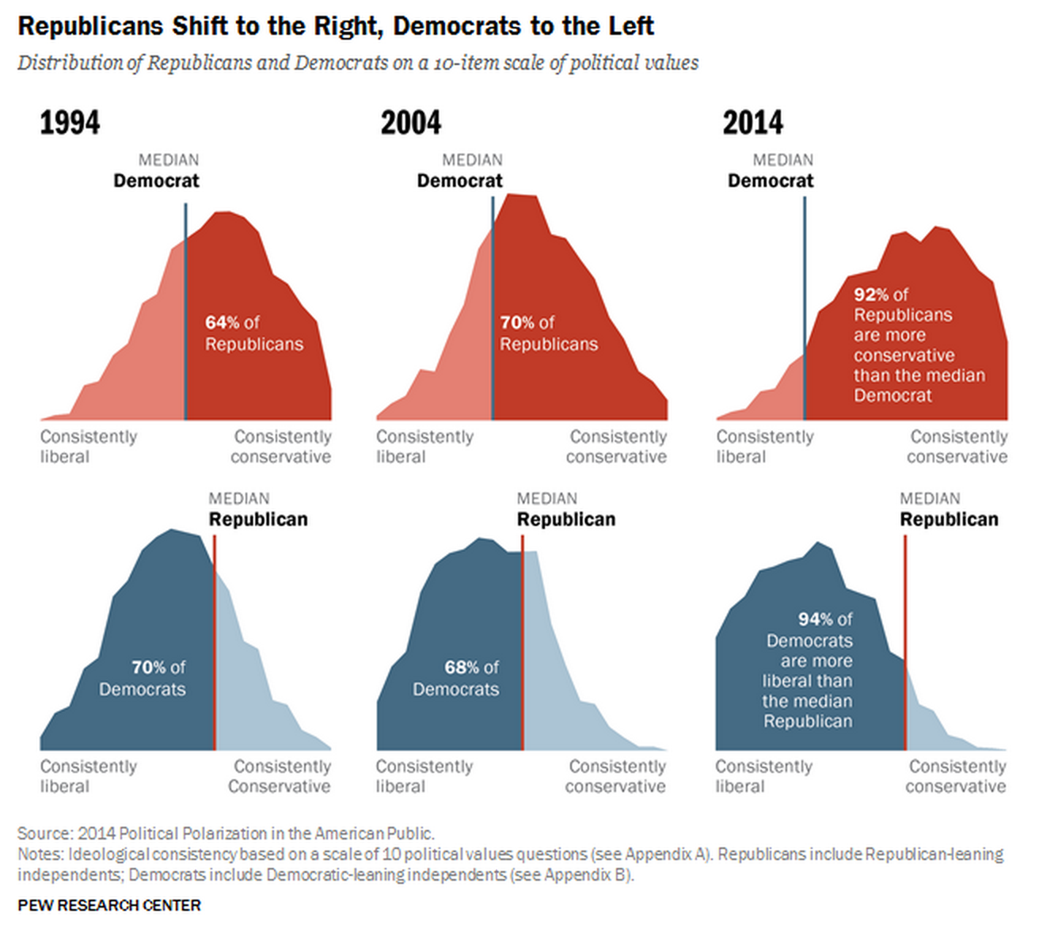
Explanatory data analysis
Annotate and tell a story

Slide 29
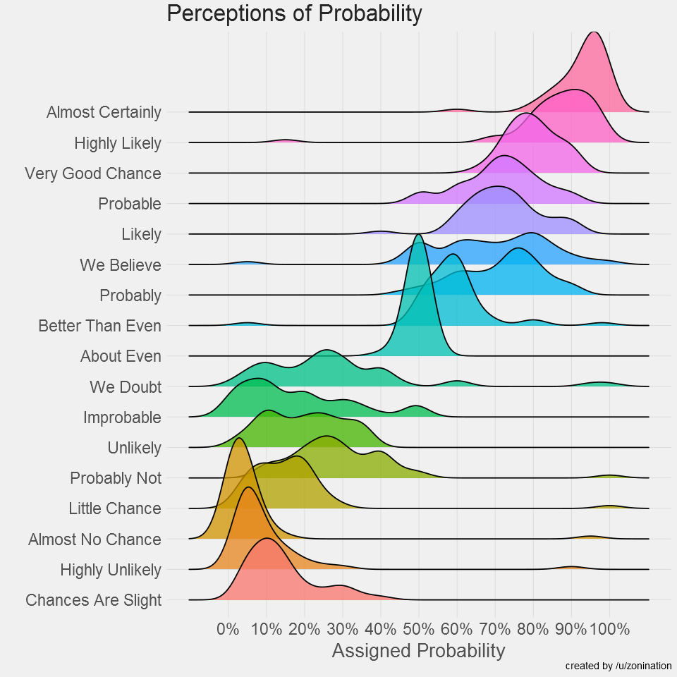
Explanatory data analysis
Annotate and tell a story

Slide 30
Which chart type do I use?
datavizcatalogue.com

Slide 31
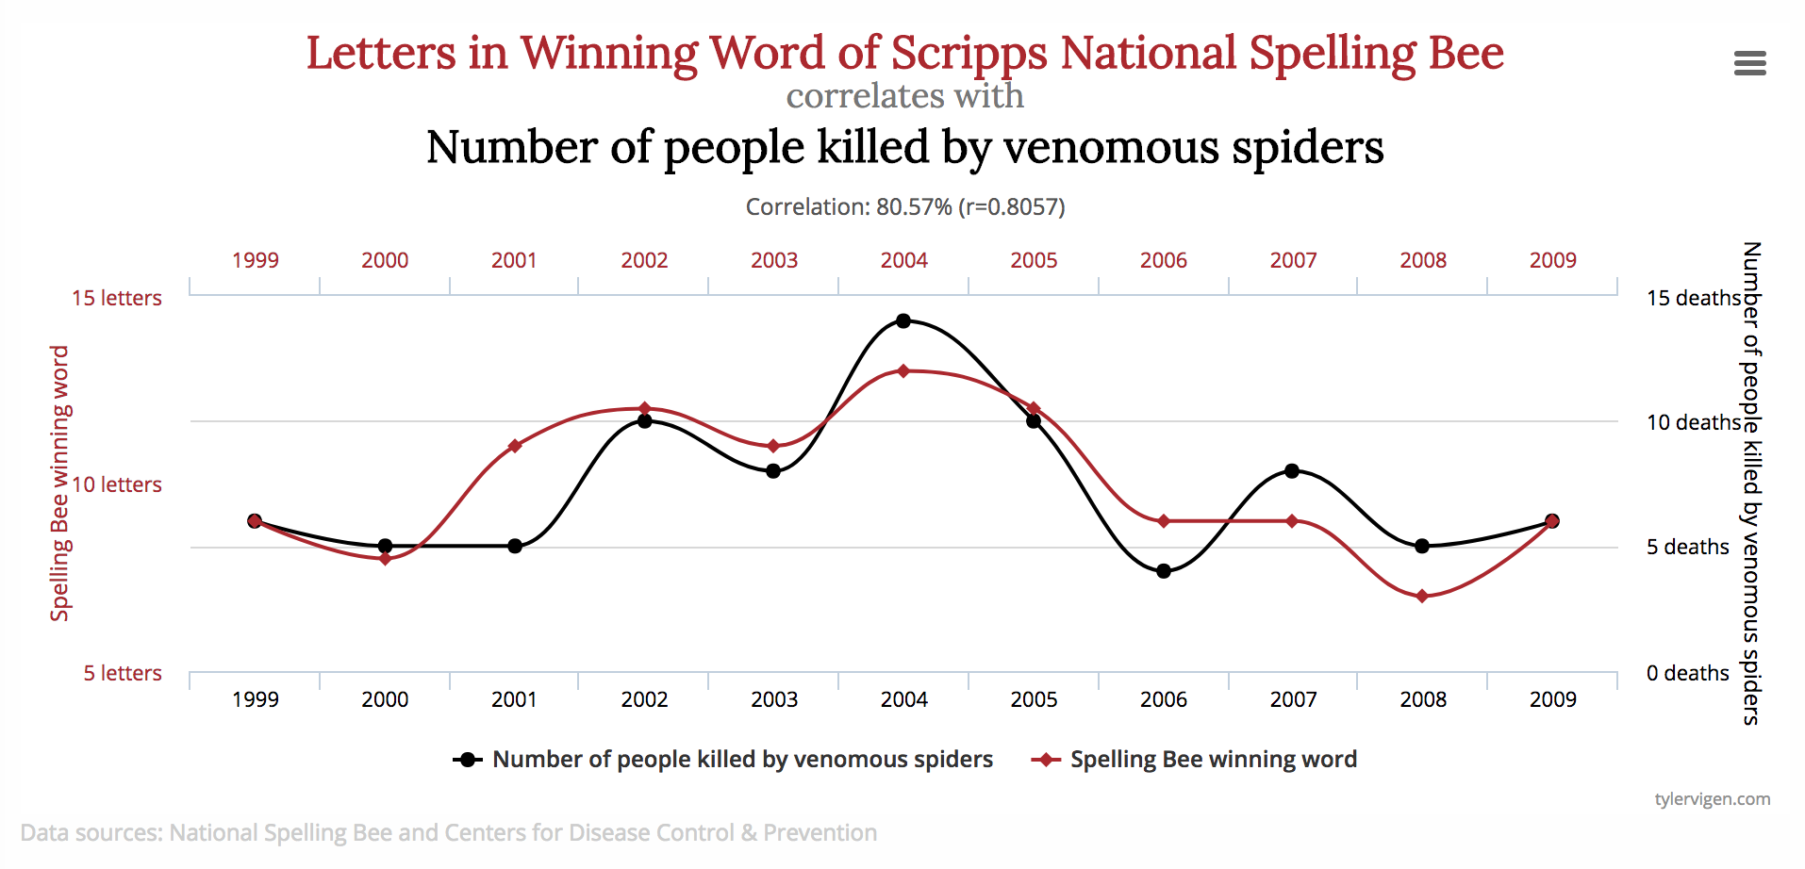
Dataviz gotchas: multiple y-axes

Slide 32
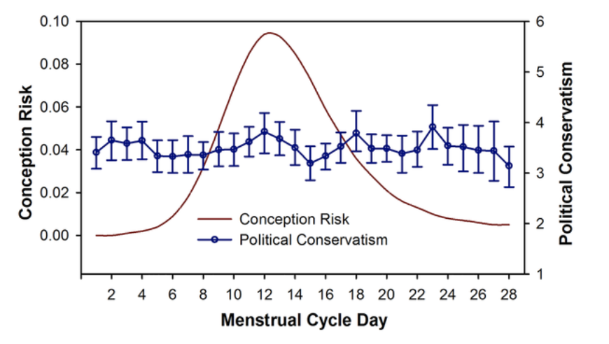
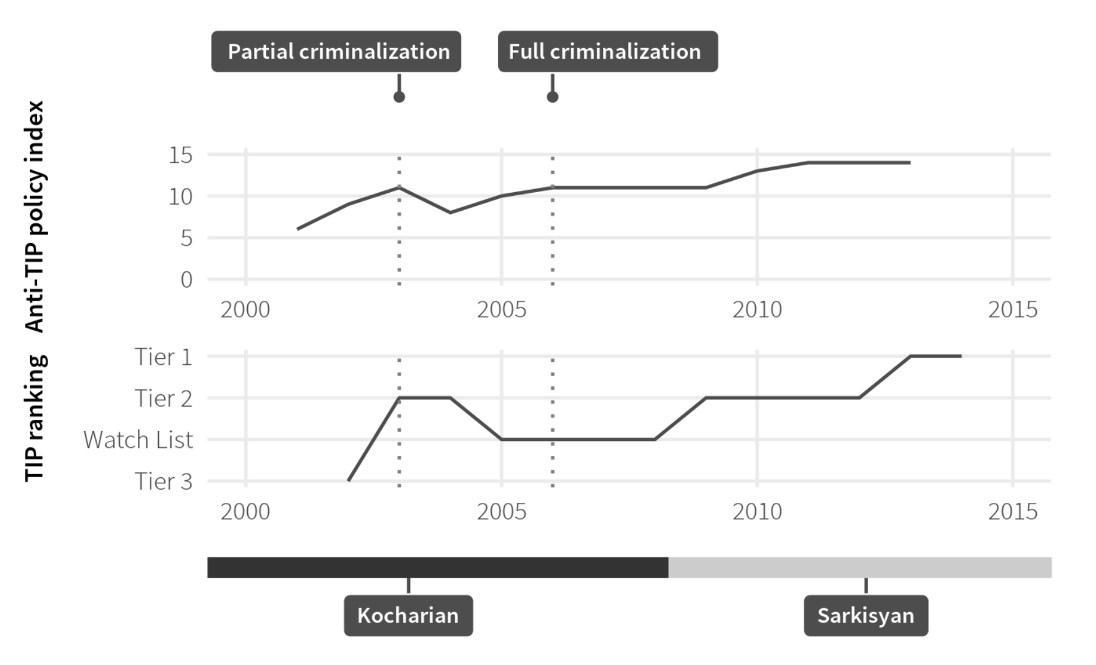
Dataviz gotchas: multiple y-axes

Slide 33
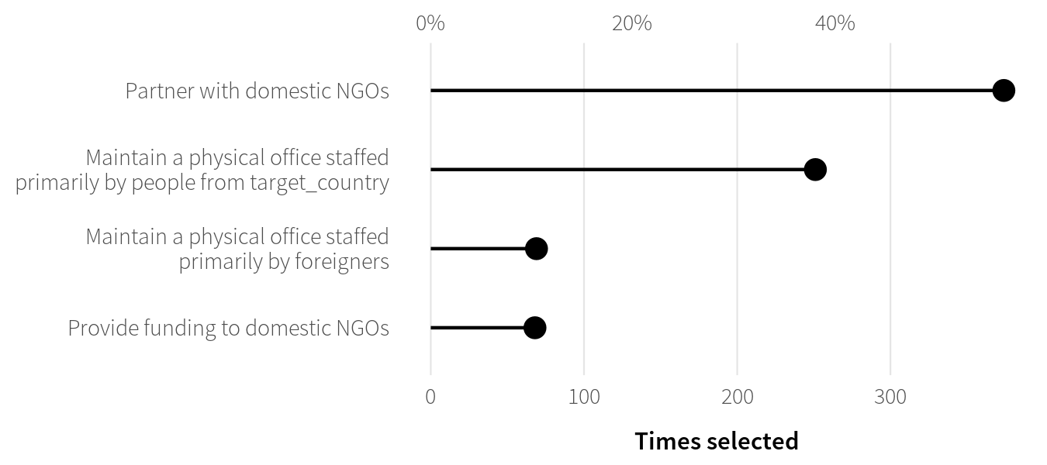
Dataviz gotchas: multiple y-axes
It’s okay if both axes measure the same thing

Slide 34
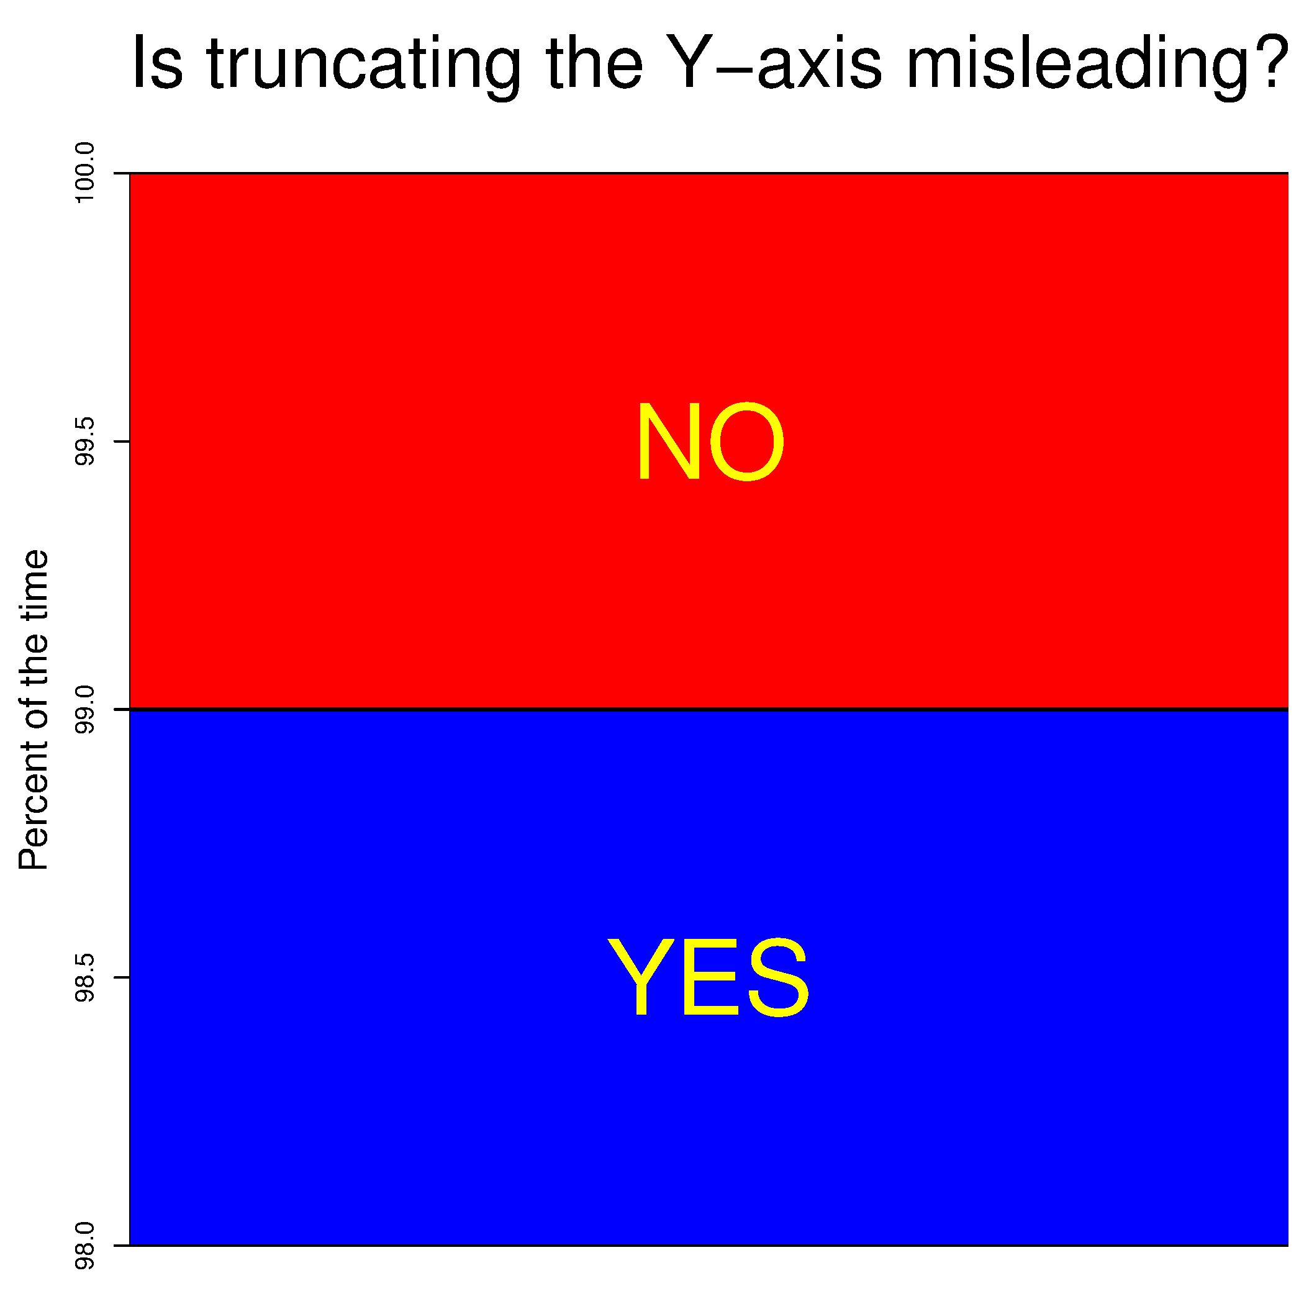
Dataviz gotchas: truncated y-axes

Slide 35
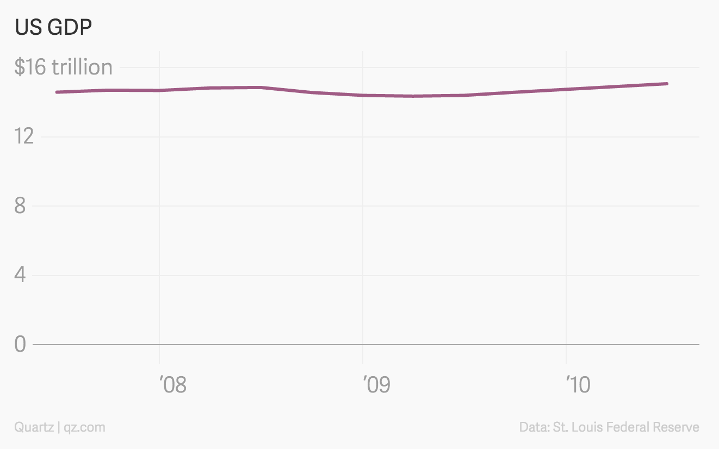
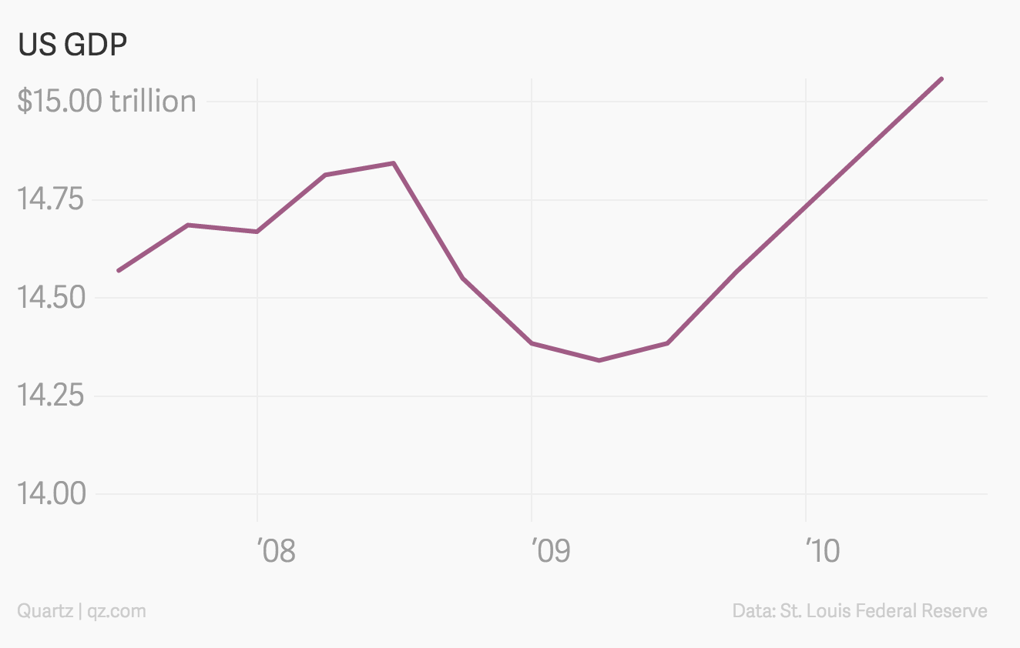
Truncation is okay sometimes!
…when small movements matter

Slide 36
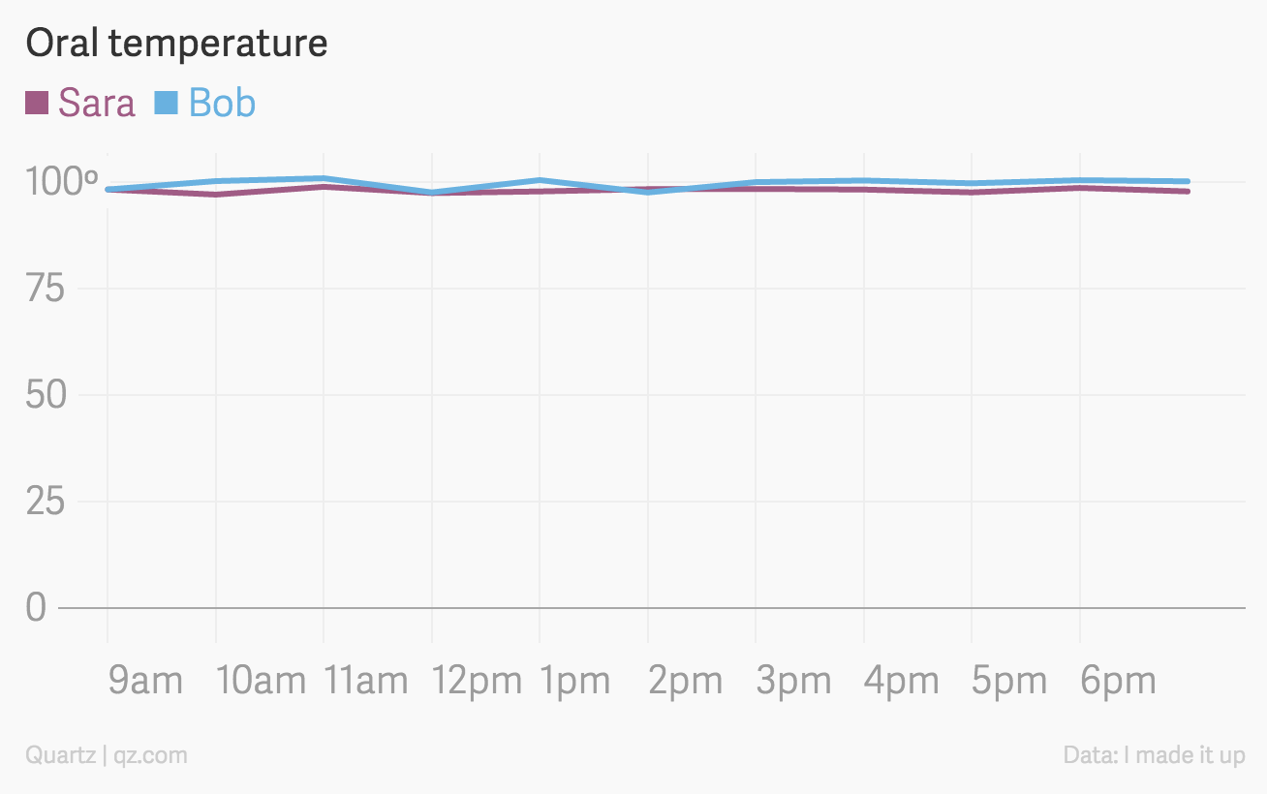
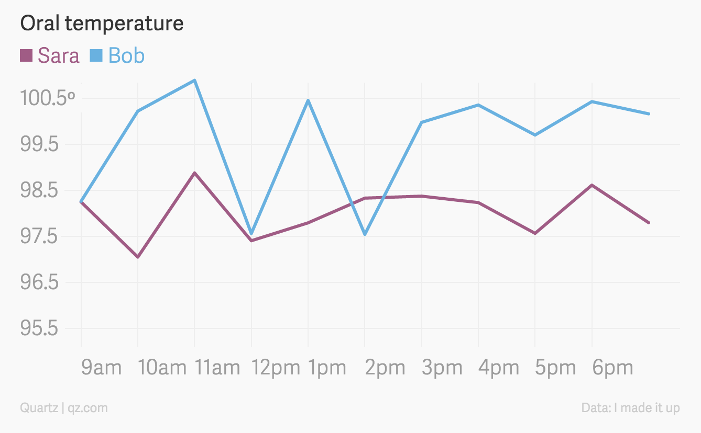
Truncation is okay sometimes!
…when zero values are impossible

Slide 37
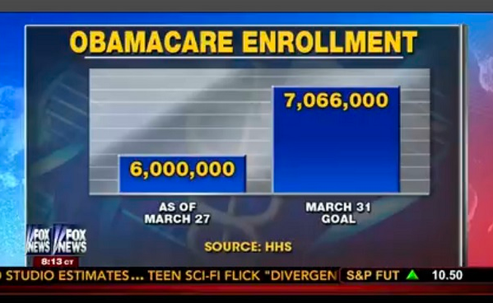
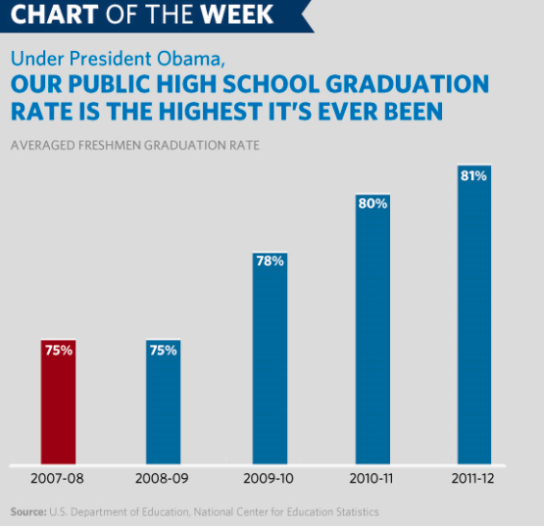
Truncation is okay sometimes!
…but never on bar charts!

Slide 38
Aesthetics and design

Slide 39




Fonts
Nice sans serif fonts; move away from Arial
Design principles
Contrast
Repetition
Alignment
Proximity

Slide 40
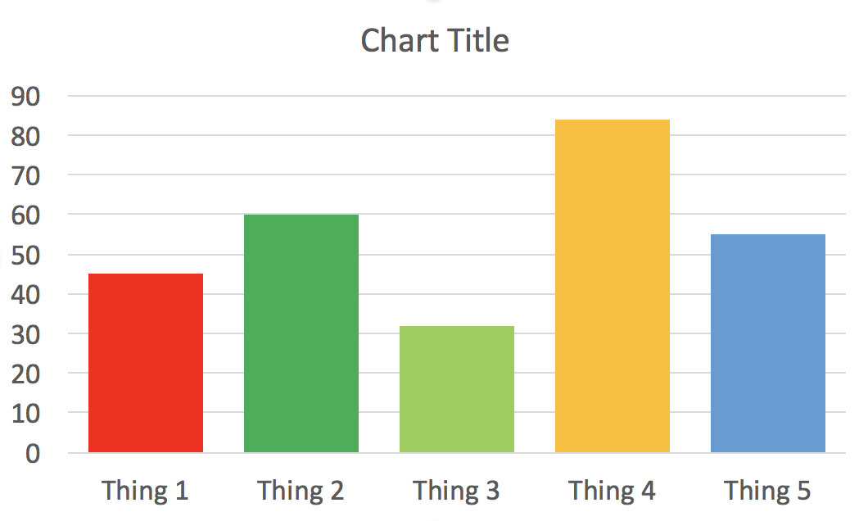
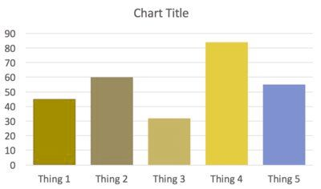
Colors
Be aware of colorblind users!

Slide 41
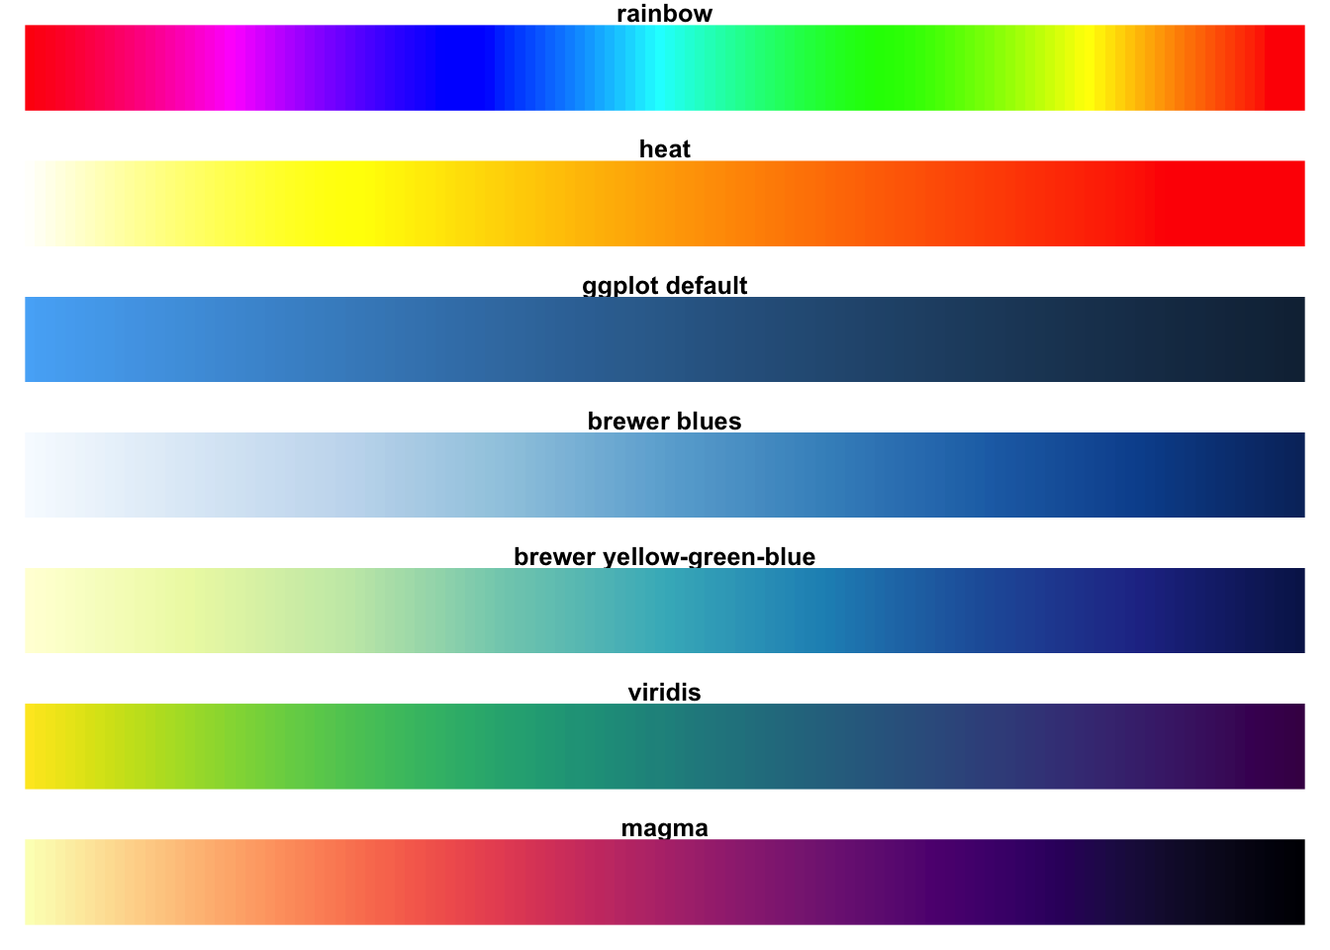
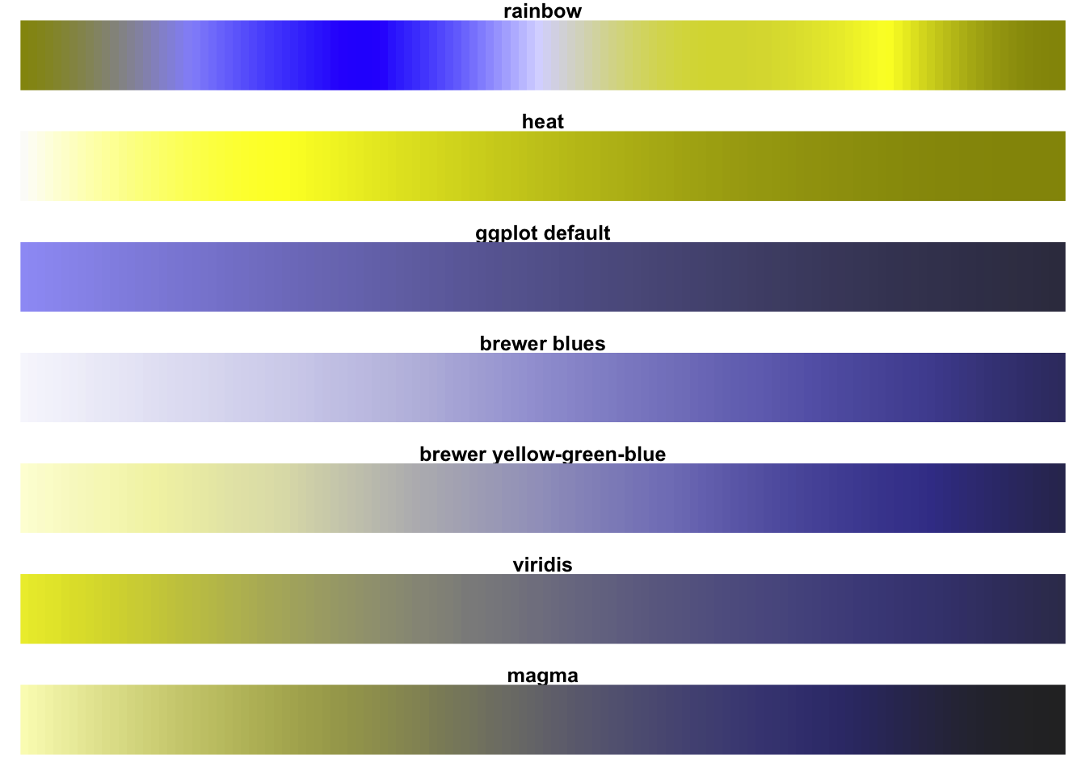
Choose universally accessible palettes

Slide 42
How do I do all this?

Slide 43






Flexibility and power
Barrier to entry (amount of coding required)

Slide 44
Take a sad plot and make it better

Slide 45
talks.andrewheiss.com/wcnpd18

